Slide 1

Next time…

Slide 2
Variable Environments I
Growth in variable environments

Slide 3

Exponential growth
$$\frac{dN}{dt}=rN$$

Slide 4

Exponential growth
$$\frac{dN}{dt}=rN$$
$$\frac{1}{N}\frac{dN}{dt}=r$$

Slide 5

Exponential growth
$$\frac{dN}{dt}=rN$$
$$\frac{d\ln{N}}{dt}=\frac{1}{N}\frac{dN}{dt}=r$$

Slide 6

Exponential growth
$$\frac{dN}{dt}=rN$$
$$\frac{d\ln{N}}{dt}=\frac{1}{N}\frac{dN}{dt}=r$$
$$\ln{N(t)}=\ln{N(0)}+rt$$
ln N
slope=r
ln N(0)
time, t

Slide 7
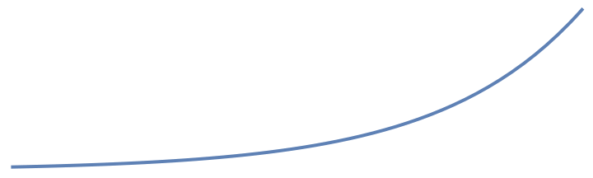

Exponential growth
$$\frac{dN}{dt}=rN$$
$$\frac{d\ln{N}}{dt}=\frac{1}{N}\frac{dN}{dt}=r$$
$$\ln{N(t)}=\ln{N(0)}+rt$$
$$N\left(t\right)=N\left(0\right)e^{rt}$$
N
N(0)
time, t

Slide 8

Variable environments
$$\frac{dN}{dt}=r(t)N$$
$$\frac{d\ln{N}}{dt}=\frac{1}{N}\frac{dN}{dt}=r(t)$$
r(t)
time, t

Slide 9
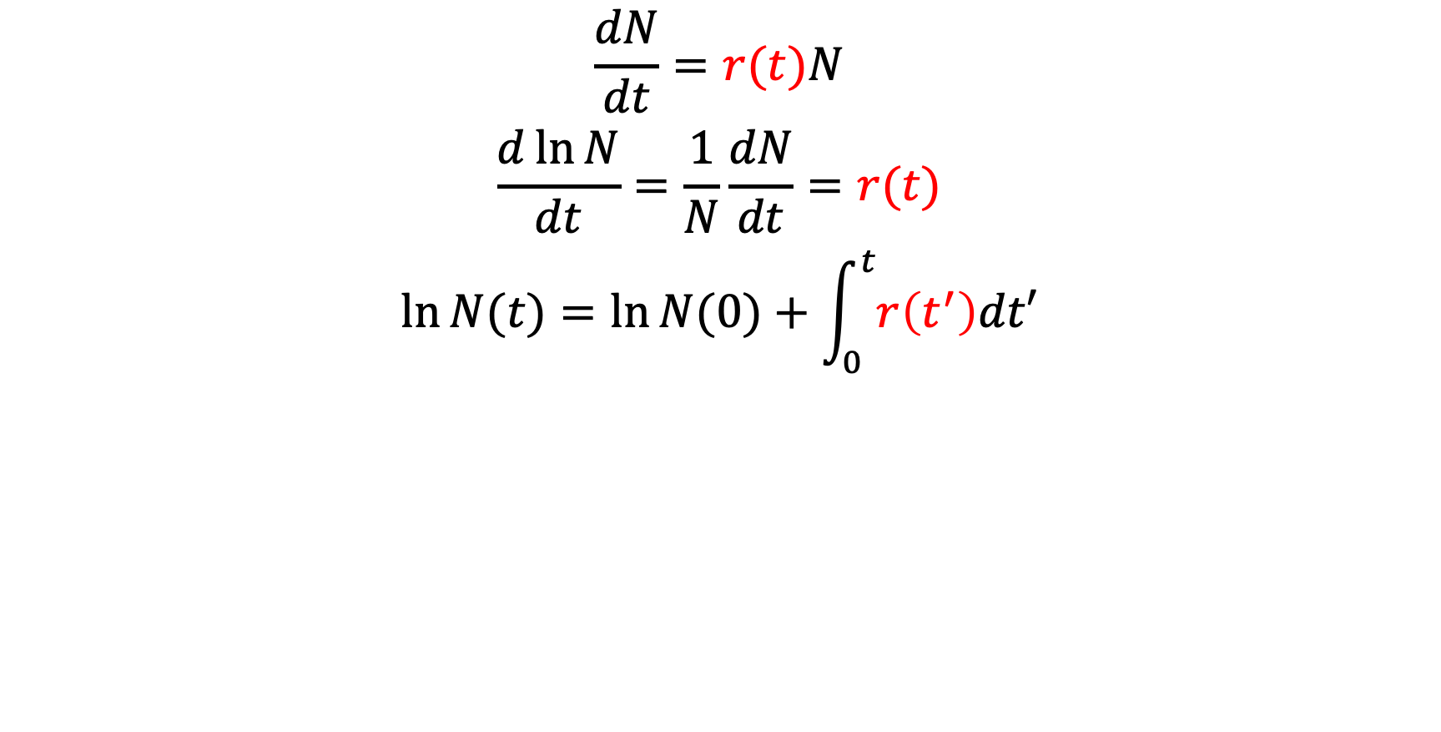
Variable environments
$$\frac{dN}{dt}=r(t)N$$
$$\frac{d\ln{N}}{dt}=\frac{1}{N}\frac{dN}{dt}=r(t)$$
$$\ln{N(t)}=\ln{N(0)}+\int_{0}^{t}{r\left(t^{′}\right)dt′}$$
ln N
r(t)
ln N(0)
time, t

Slide 10
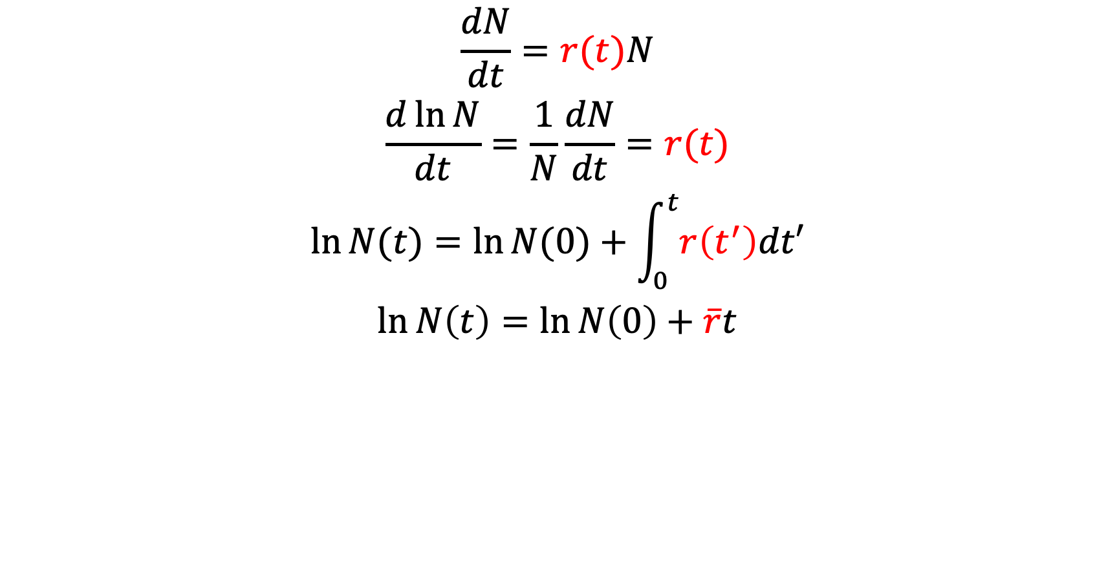
Variable environments
$$\frac{dN}{dt}=r(t)N$$
$$\frac{d\ln{N}}{dt}=\frac{1}{N}\frac{dN}{dt}=r(t)$$
$$\ln{N(t)}=\ln{N(0)}+\int_{0}^{t}{r\left(t^{′}\right)dt′}$$
$$\ln{N\left(t\right)=\ln{N\left(0\right)+\overline{r}t}}$$
ln N
r(t)
ln N(0)
time, t

Slide 11
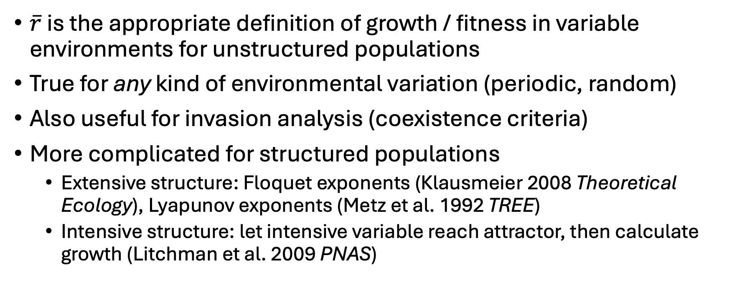
Variable environments
$\overline{r}$ is the appropriate definition of growth / fitness in variable environments for unstructured populations
True for any kind of environmental variation (periodic, random)
Also useful for invasion analysis (coexistence criteria)
More complicated for structured populations
Extensive structure: Floquet exponents (Klausmeier 2008 Theoretical Ecology), Lyapunov exponents (Metz et al. 1992 TREE)
Intensive structure: let intensive variable reach attractor, then calculate growth (Litchman et al. 2009 PNAS)

Slide 12
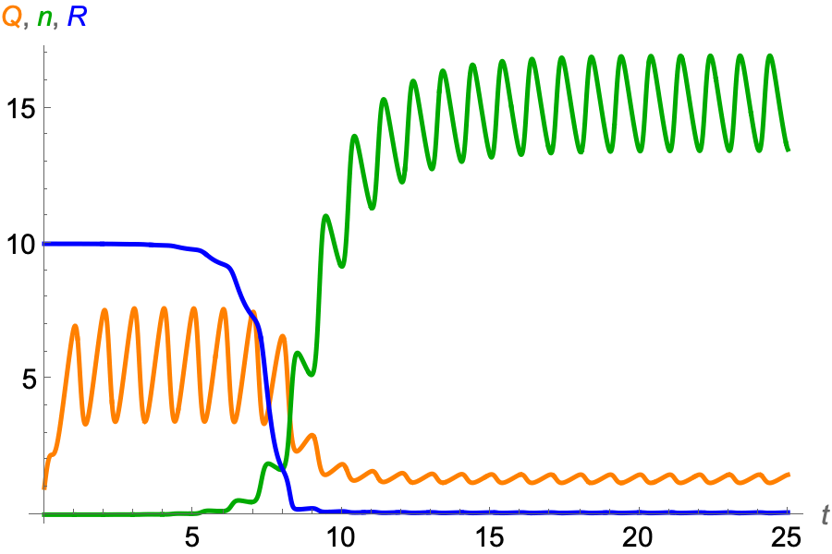
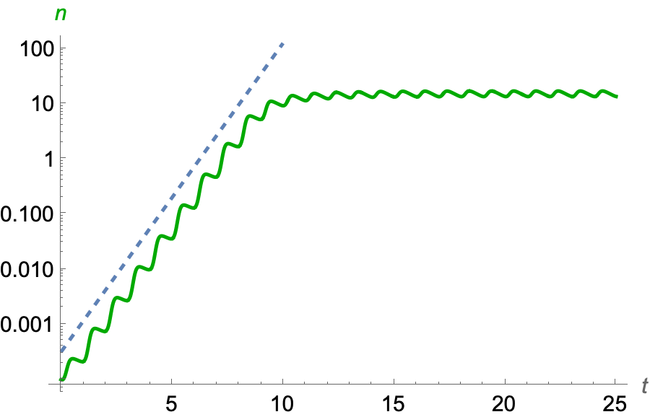
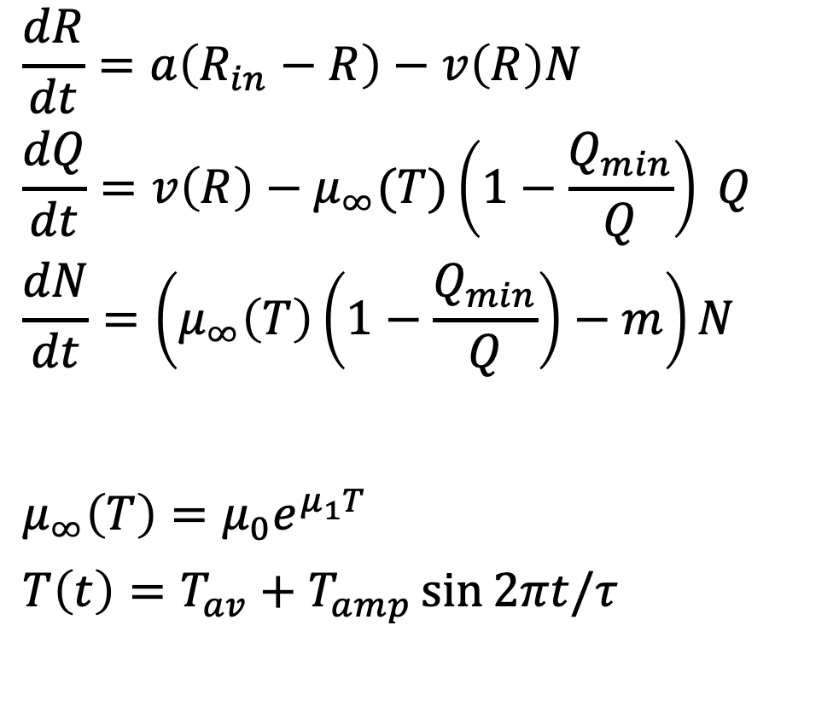
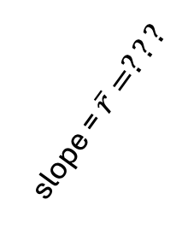
Intensive structure (Droop model) + periodic forcing
$$\frac{dR}{dt}=a\left(R_{in}−R\right)−v\left(R\right)N$$
$$\frac{dQ}{dt}=v\left(R\right)−μ_{∞}(T)\left(1−\frac{Q_{min}}{Q}\right) Q$$
$$\frac{dN}{dt}=\left(μ_{∞}\left(T\right)\left(1−\frac{Q_{min}}{Q}\right)−m\right)N$$
$$μ_{∞}\left(T\right)=μ_{0}e^{μ_{1}T}$$
$$T\left(t\right)=T_{av}+T_{amp}\sin{2πt/τ}$$
slope = $\overline{r}=???$

Slide 13
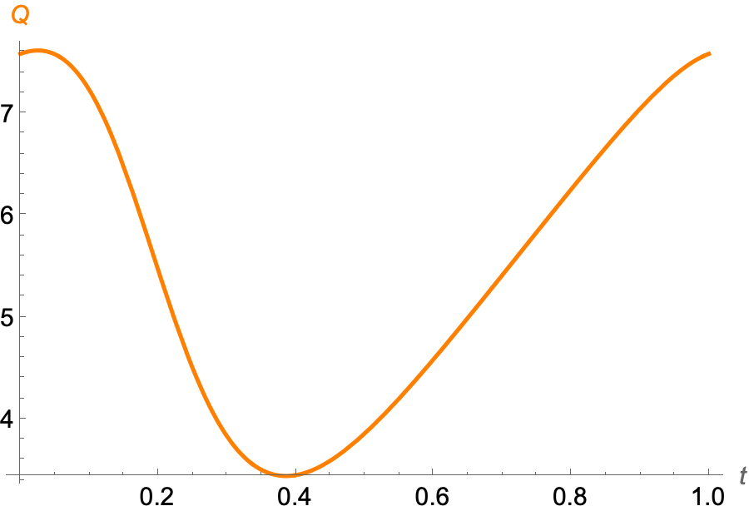
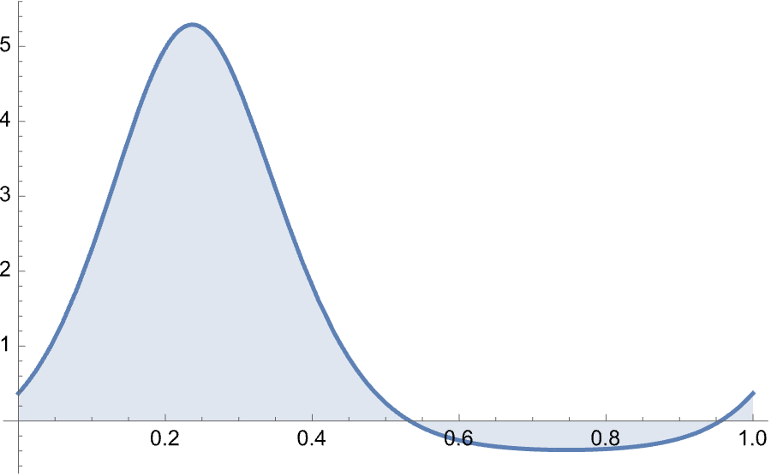
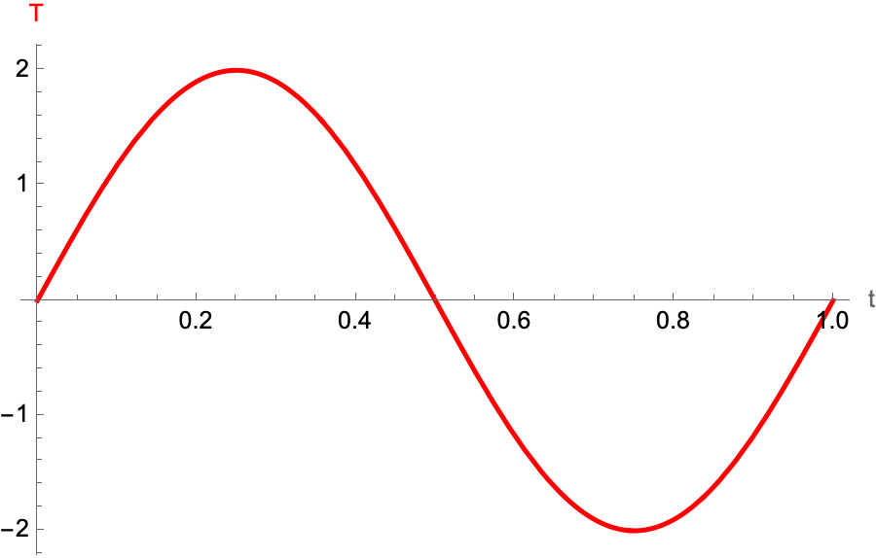
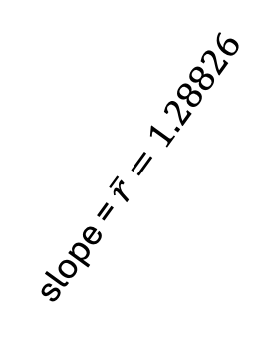
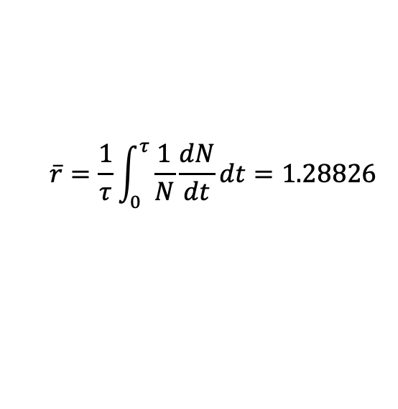

1) Numerically solve for quota dynamics forced by temperature:
2) Plug quota dynamics into per capita growth rate:
3) Average instantaneous per capita growth rate over one period to calculate growth rate:
quota, Q
$$\left(1/N\right)dN/dt$$
$$\overline{r}=\frac{1}{τ}\int_{0}^{τ}{\frac{1}{N}\frac{dN}{dt}dt}=1.28826$$
✅ Compare calculated growth rate with simulation:
temperature, T
slope = $\overline{r}=1.28826$

Slide 14
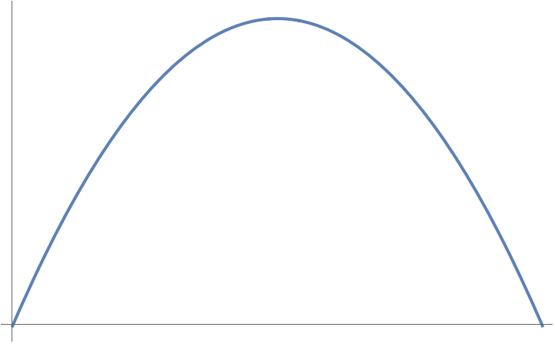




Nonlinear averaging (AKA Jensen’s inequality)
Unless $r(x)$ is linear, $\overline{r(x)}≠r(\overline{x})$
$$r(\overline{x})$$
$$r(x)$$
$$\overline{x}$$
$$x$$

Slide 15
Nonlinear averaging (AKA Jensen’s inequality)
Unless $r(x)$ is linear, $\overline{r(x)}≠r(\overline{x})$
$$r(\overline{x})$$
$$r(x)$$
$$\overline{x}$$
$$x$$

Slide 16


Nonlinear averaging (AKA Jensen’s inequality)
$$\overline{r(x)}<r(\overline{x})$$
$$r(\overline{x})$$
$$\overline{r(x)}$$
$$r(x)$$
$$\overline{x}$$
$$x$$

Slide 17
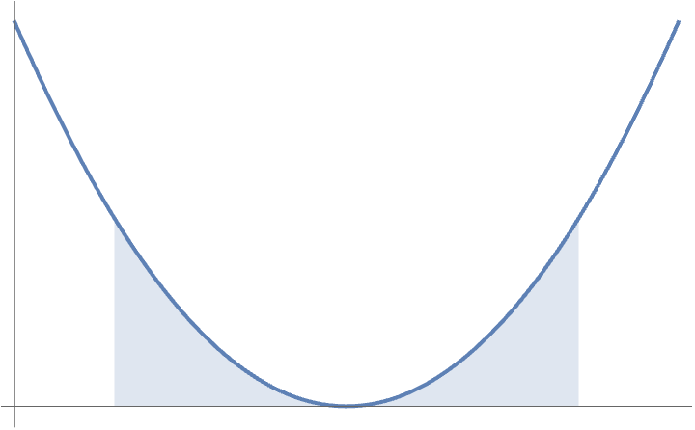






Nonlinear averaging (AKA Jensen’s inequality)
$$\overline{r(x)}<r(\overline{x})$$
$$\overline{r(x)}>r(\overline{x})$$
$$r(\overline{x})$$
$$\overline{r(x)}$$
$$r(x)$$
$$r(x)$$
$$\overline{r(x)}$$
$$r(\overline{x})$$
$$\overline{x}$$
$$x$$
$$\overline{x}$$
$$x$$

Slide 18
Nonlinear averaging (AKA Jensen’s inequality)
$$\overline{r(x)}≈r\left(\overline{x}\right)+\text{1/2 }\text{Var}(x)\frac{d^{2}r}{dx^{2}}$$
$$\overline{r(x)}<r(\overline{x})$$
$$\overline{r(x)}>r(\overline{x})$$
$$r(\overline{x})$$
$$\overline{r(x)}$$
$$r(x)$$
$$r(x)$$
$$\overline{r(x)}$$
$$r(\overline{x})$$
$$\overline{x}$$
$$x$$
$$\overline{x}$$
$$x$$
(Ruel & Ayres 1999, Denny 2017)

Slide 19


Slide 20
Initial discussion
Any technical questions?
What are the main conclusions of the paper?
TPC vs TBC
T_{K}<T_{r}
Better to be too cold than too hot (also in dynamic environment)
What other questions should we discuss?

Slide 21
Some discussion questions
Do you agree with the assumptions in the model?
What would be some good next steps?
Do interspecific interactions (competition) have the same effect?
Left-skewed TPC – where does it come from? Is it inevitable?

